Slide 1
Value Function Factorization For Cooperative Multi-agent Reinforcement Learning
Hanhan Zhou
For Course ECE 6882 by Prof. Tian Lan

Slide 2
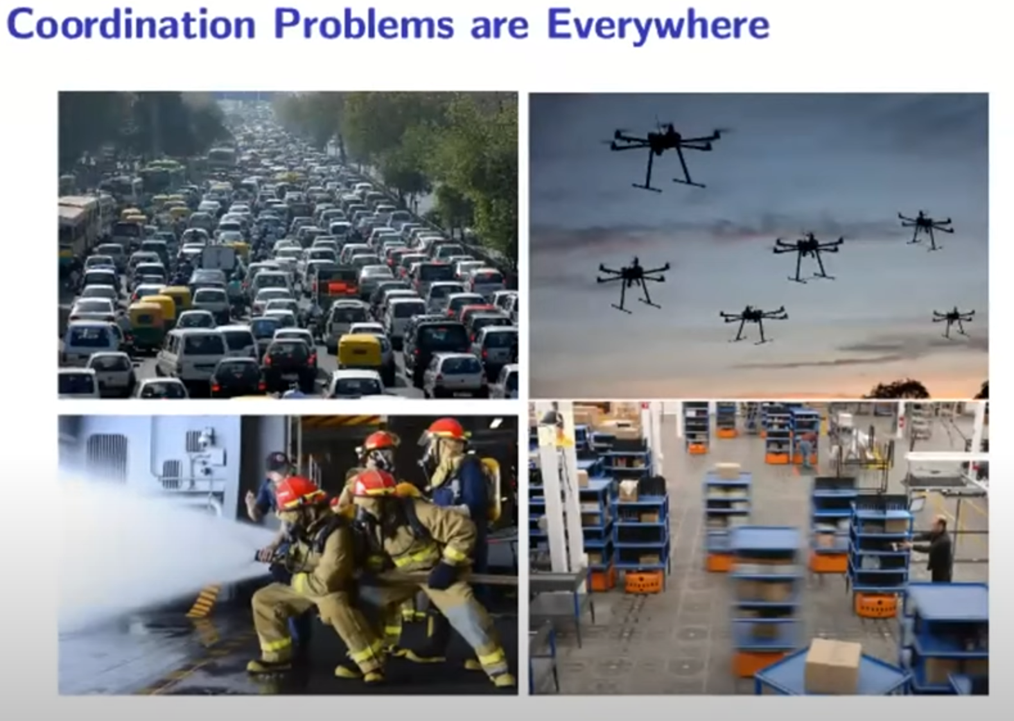
Coordination Problems Are Everywhere

Slide 3
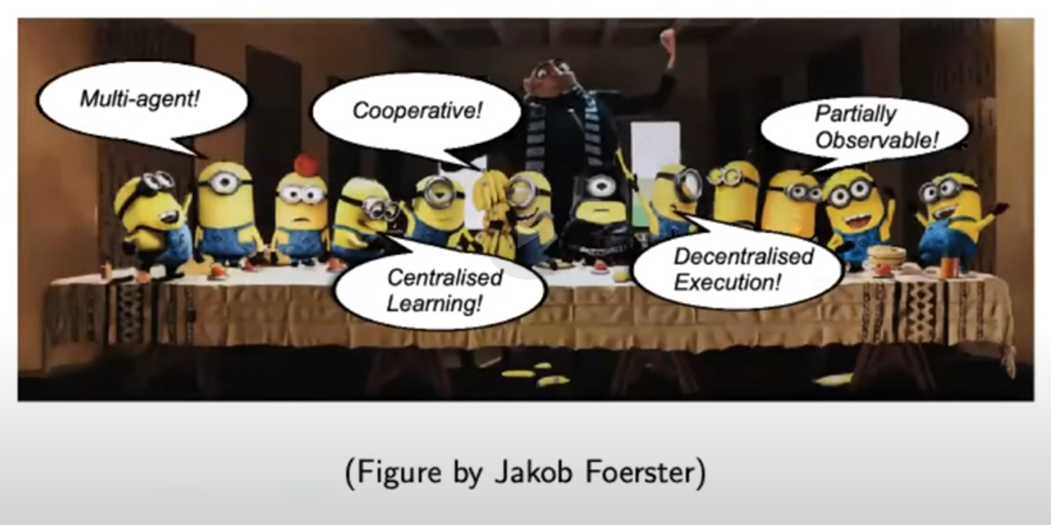
Setting (in 1 pic)

Slide 4
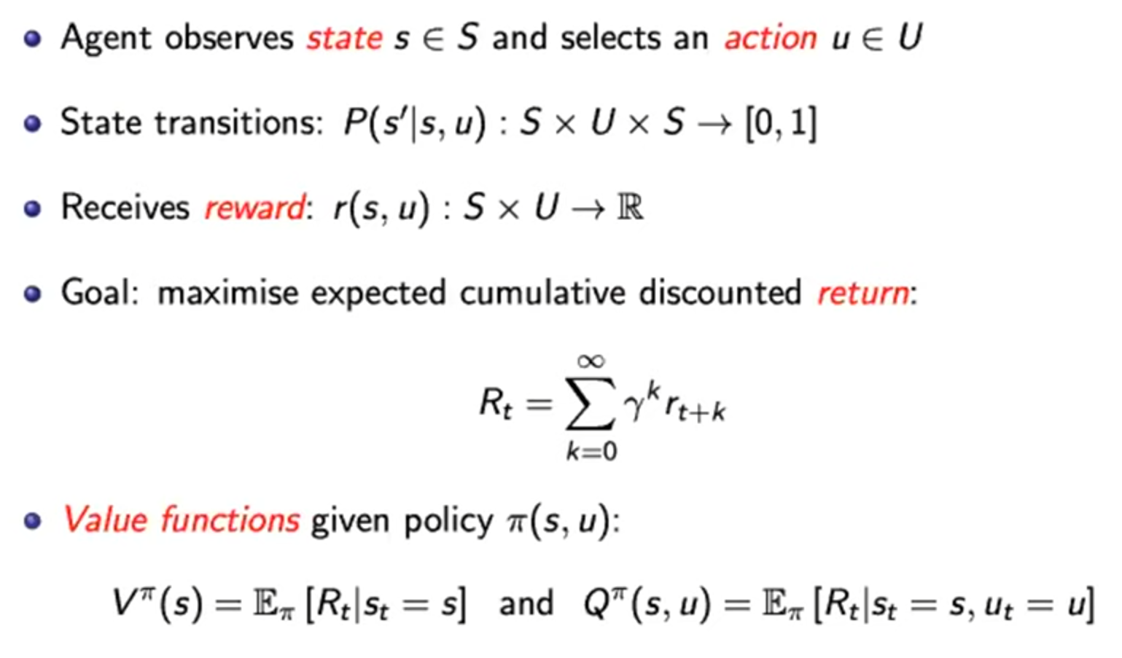
Markov Decision Process

Slide 5
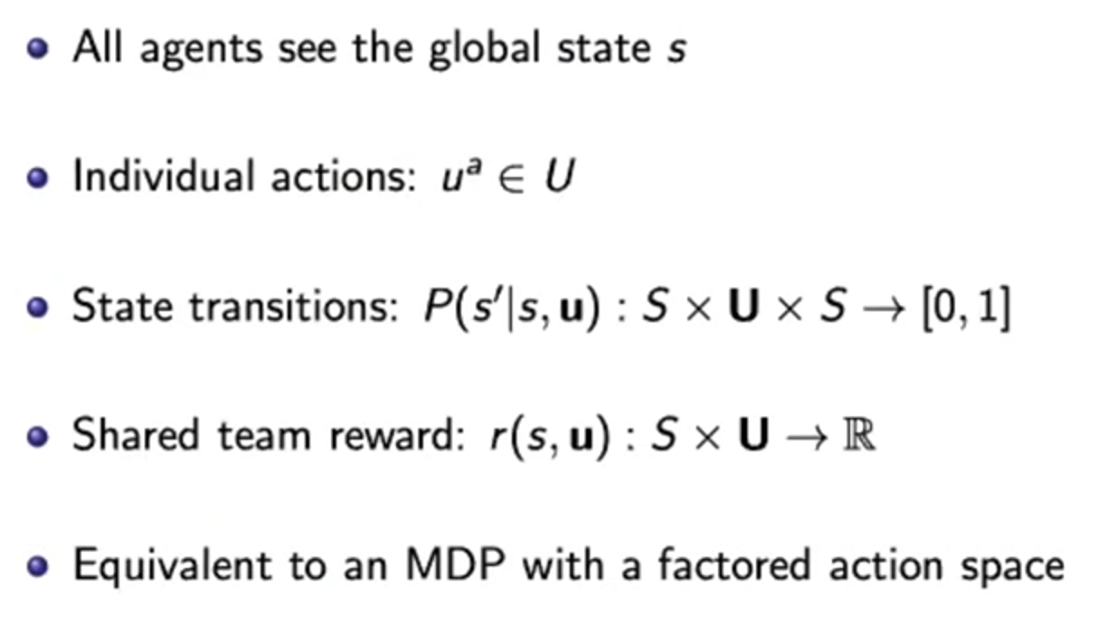
Multi-Agent Markov Decision Process

Slide 6
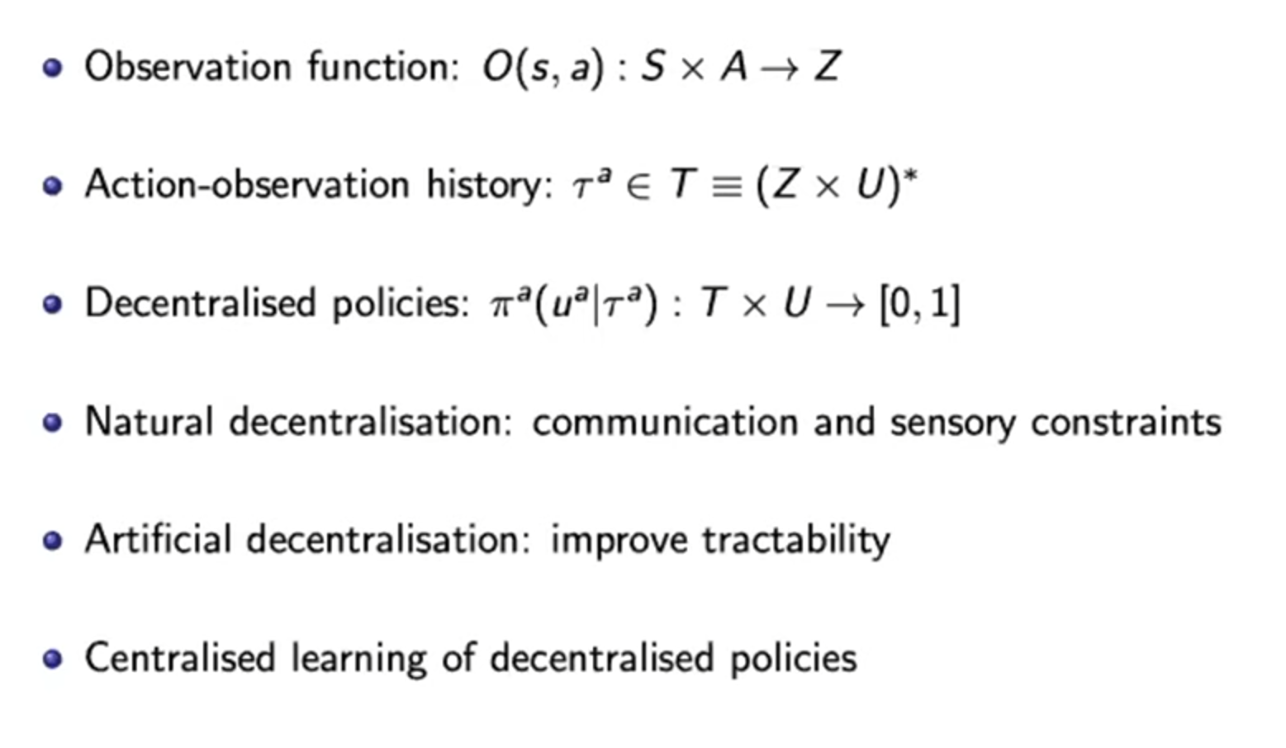
Decentralized Partially Observable Markov Decision Process (POMDP)

Slide 7
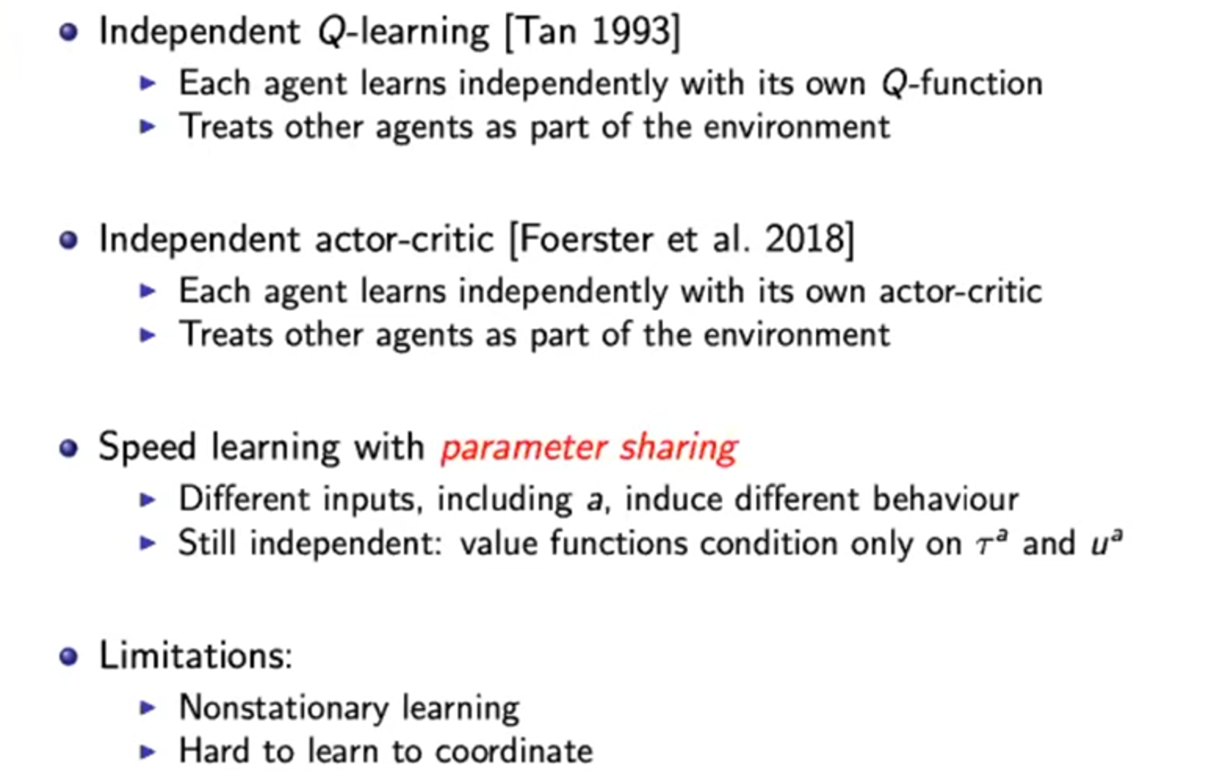
Independent Learning

Slide 8
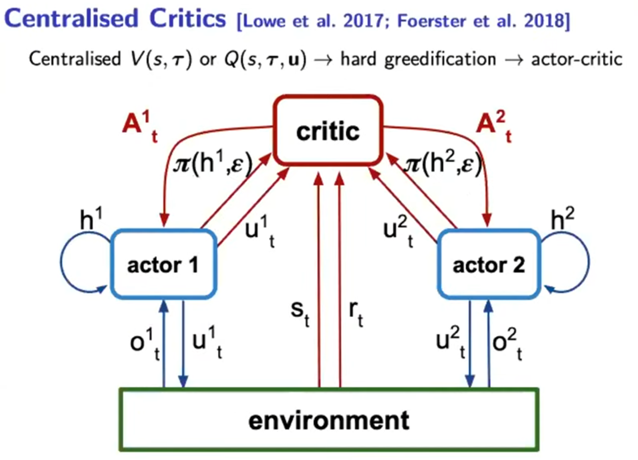
Centralized Critics

Slide 9
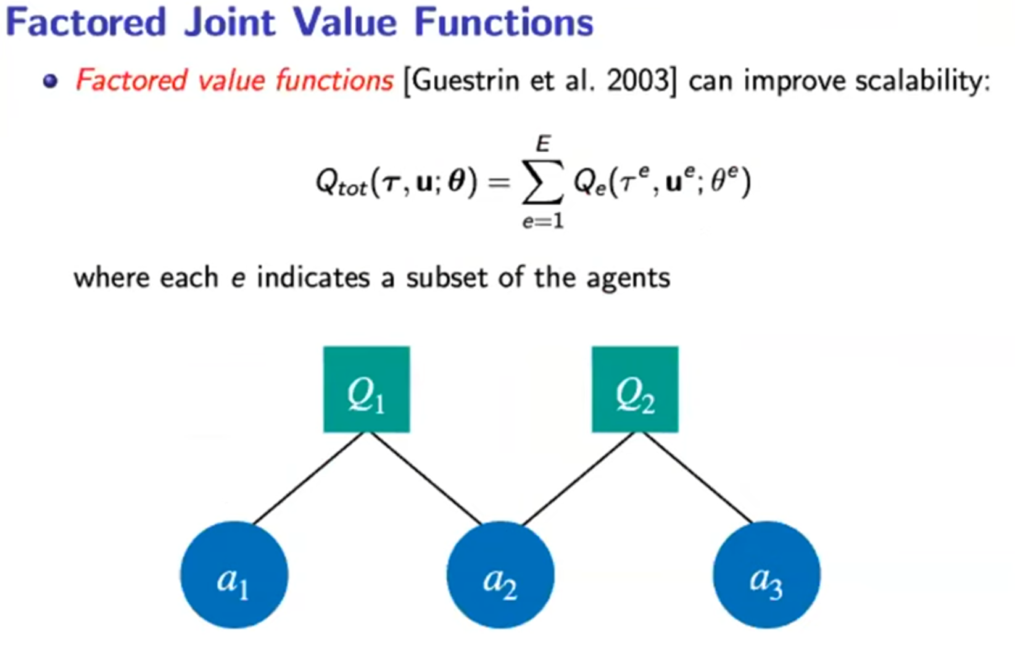

Slide 10
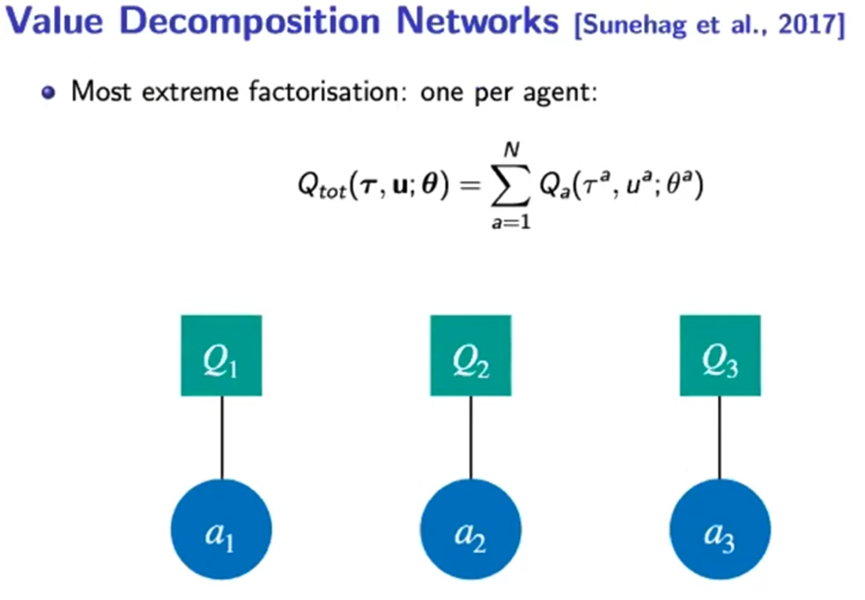

Slide 11
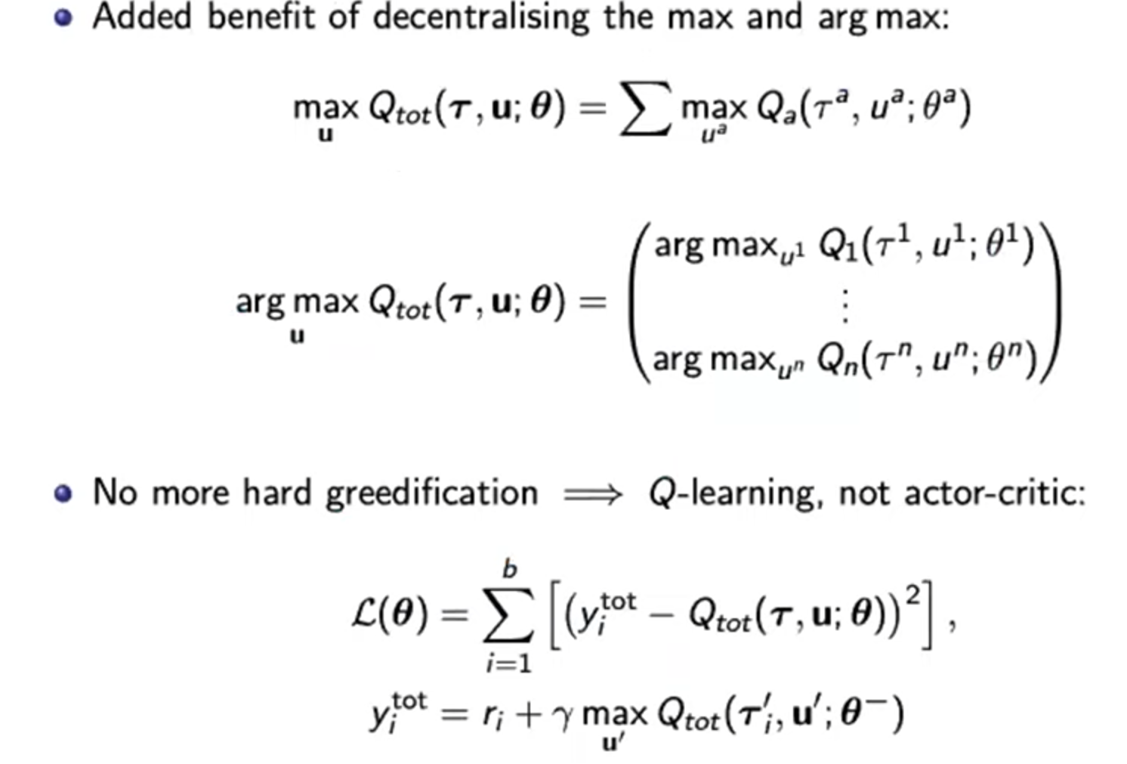
Decentralisability

Slide 12
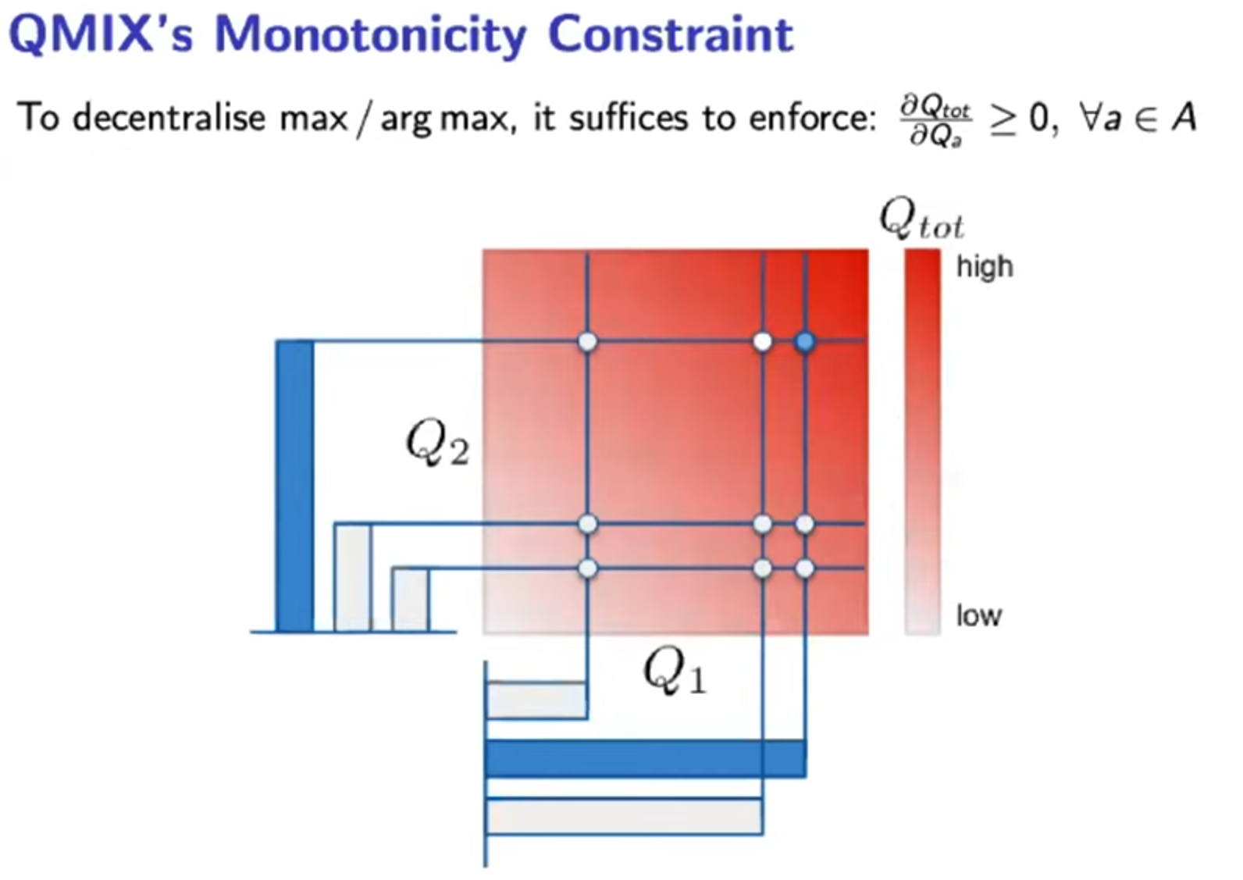

Slide 13
